Slide 1
HR Analytics
July 2021
Ramya D, DSC 27

Slide 2
Contents
Objectives
Overall Approach
Data Cleaning
Exploratory Data Analysis – Univariate, Bivariate and Correlation analysis
Modelling Approach – Logistic Regression
Alternative implementation in Logistic Regression
Conclusions

Slide 3


Key Objectives
Identify various patterns among employees who leave the organization and predict the attrition rate
Identify patterns which indicate if an employee will leave the organization
The results thus obtained will be used by the management to understand what changes they should make to their workplace, in order to get most of their employees to stay.
Understand how different attributes influence the tendency of employees to leave the organization

Slide 4
Inspecting Datasets
Given dataset contains information of applicants at both the time of application as well as their previous loans data
The in_time and out_time datasets contains the entry time and exit times of all the employees for the last year
General_data contains all the generic information and the organization related information about all the employees
Employee survey data contains how the employees are feeling about the workplace and their work life balance
Manager_survey data contains data about how their line managers perceive about employee
There are a total of 4410 employees in the organization
We’ve extracted the median time each employee works in the organization and combined all the datasets using the primary key EmployeeID

Slide 5
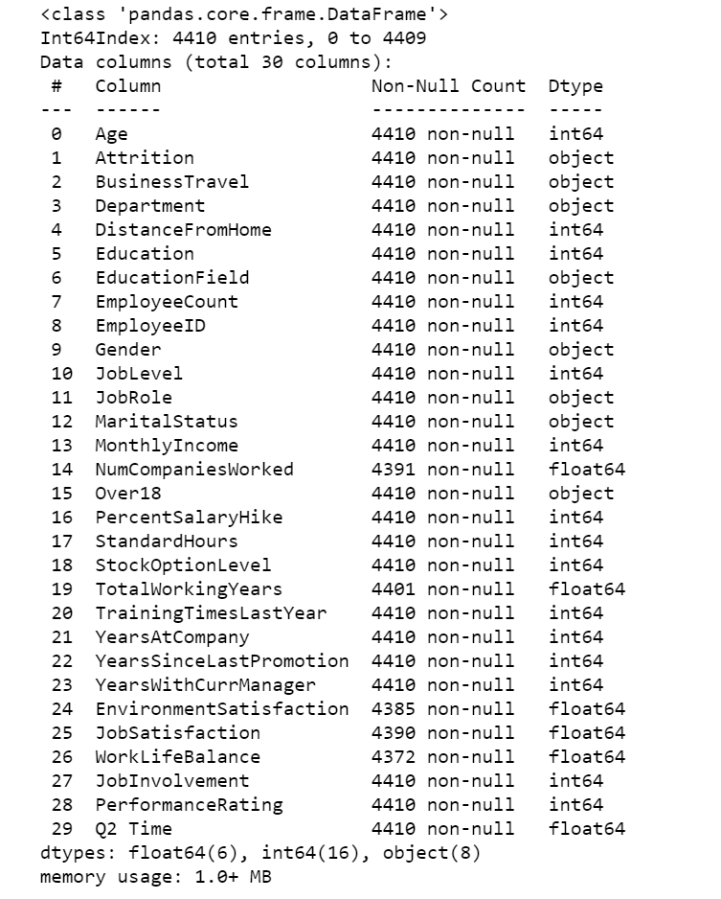
Missing value analysis
Final dataset has 4410 rows and 30 columns. Of these columns, there are a few missing values in just 4 columns

Slide 6
Data Cleaning
Different approaches are used for different columns to not include any bias in our analysis
Columns EmployeeCount, Over18 and Standard Hours are just variables with just one value and are dropped for modelling
Missing values in EnvironmentSatisifcation is imputed with the level ‘High’
Jobsatisfcation is imputed with the level ‘High’
‘WorkLifeBalance’ is imputed with ‘Better’
Numcompaniesworked is imputed with a value of 2

Slide 7
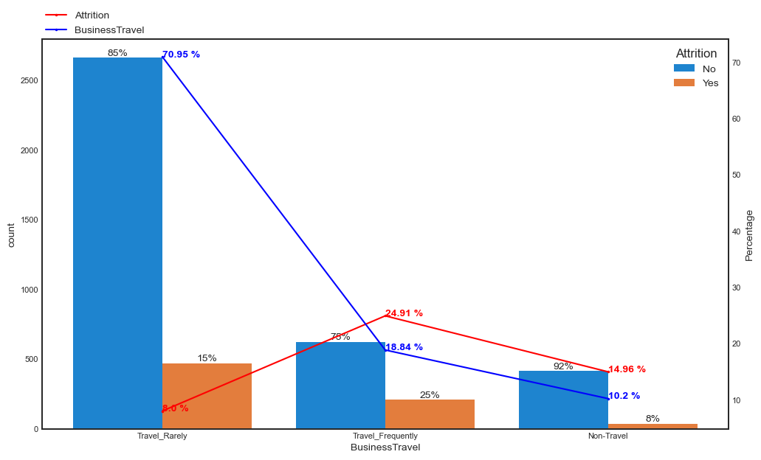
Univariate Analysis
Most of the employees just `Travel Rarely` (almost 70.95%) and this category has the lowest attrition rate among all the business travel levels
-As expected employee who `Travel Frequently` have the highest attrition rate

Slide 8
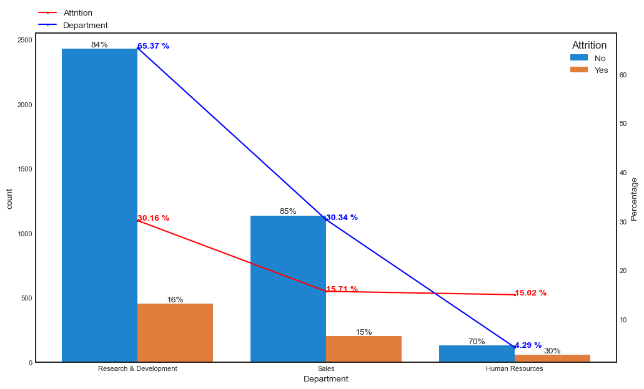
Univariate Analysis
From the above graph, we can see that the Deparment `Research & Development` has the highest share of employees and also a higher attrition rate compared to other departments
`HR` department share is just 4.29%

Slide 9
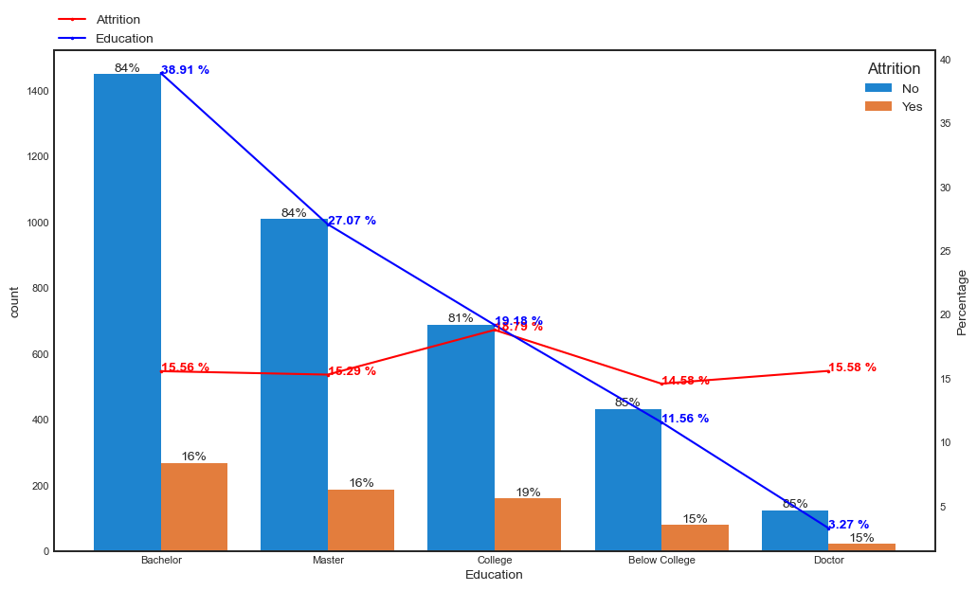
Univariate Analysis
Clearly `Education` doesnt have any effect on the attrition rate and is almost constant across different levels of Education
Employees with doctorates are just 3.27% of the whole organization and the major category in Education is Bachelor with almost 38.91%

Slide 10
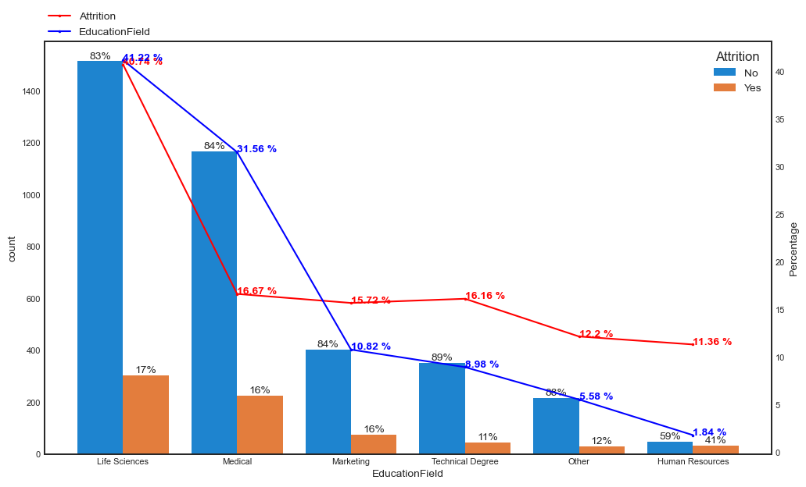
Univariate Analysis
There is a high attrition rate of 40.74% in Employees who come from `EducationField` of Life Sciences
Attrition rate is almost constant among the remaining Education Fields

Slide 11
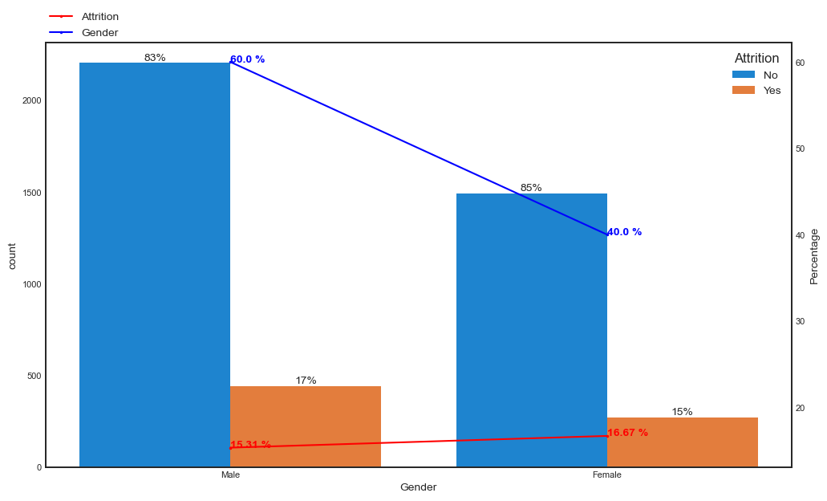
Univariate Analysis
The organization has a male-female ratio of 60: 40 and the attrition rate is almost same among both genders.

Slide 12
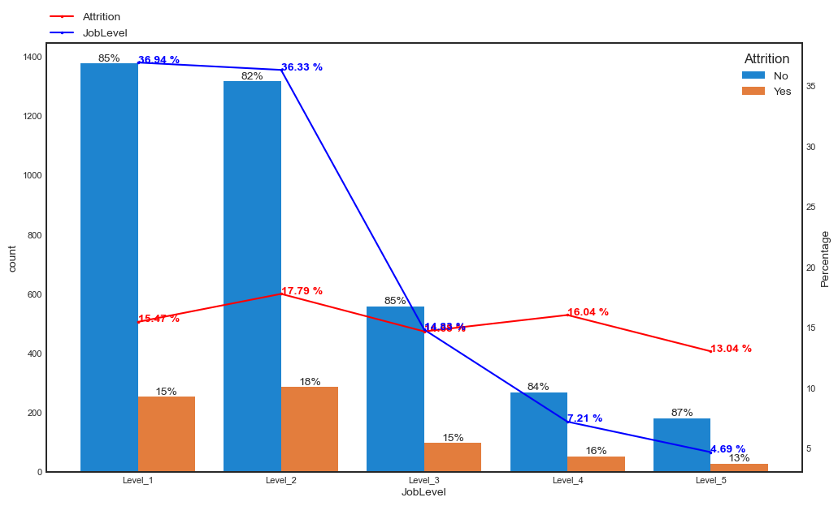
Univariate Analysis
Attrition rate is almost constant across all joblevels

Slide 13
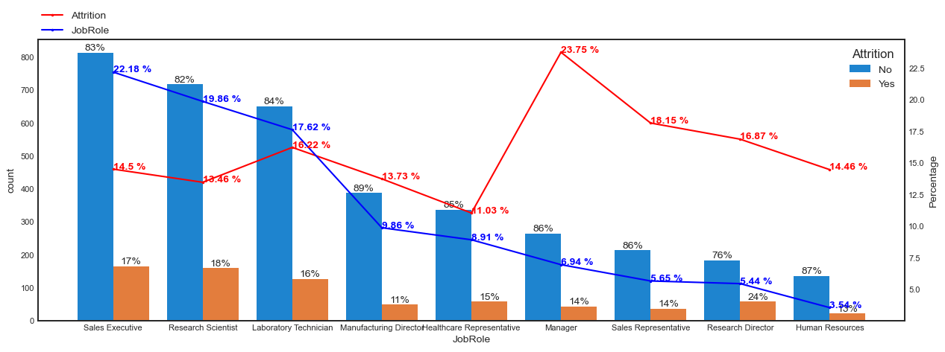
Univariate Analysis
SalesExecutives have the highest share in employees (22.18%) and has a attrition rate close to 15%
Though Managers account to only 6.94% of the total population, they have a marginally higher attrition rate of 23.75%

Slide 14
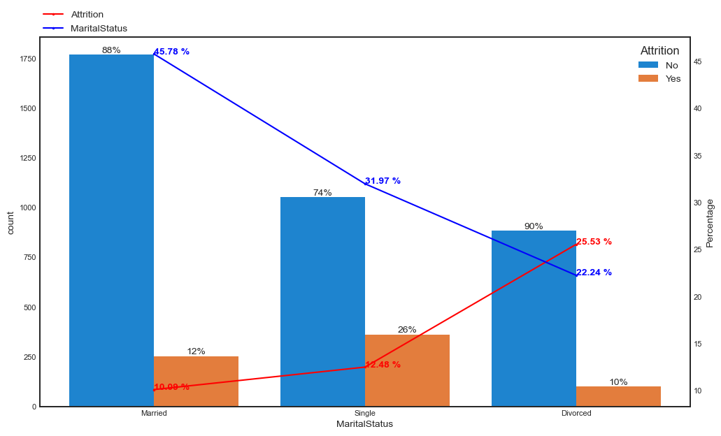
Univariate Analysis
Attrition rate is lowest among `Married` employees and it is highest among `Divorced` employees

Slide 15
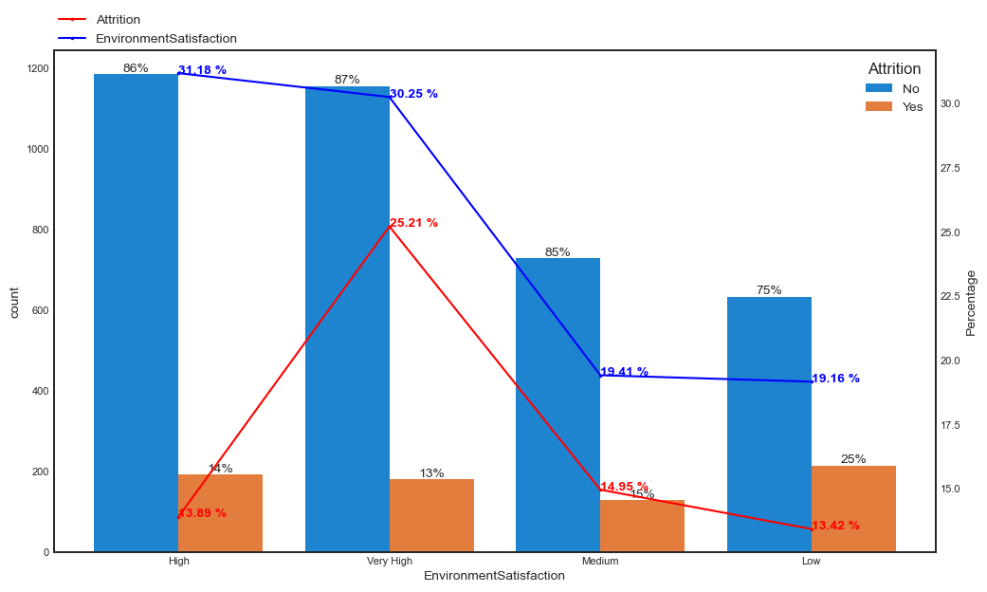
Univariate Analysis
Surprisingly even though employees who rate the `EnvironmentSatisfcation` are almost same in terms of total proportion (31% and 30.25% respectively), there is a start difference of almost 20% in attrition rate. Employees who rated `EnvironmentSatisfication` as Very High has a high attrition rate of 30.25%
There is a constant lower attrition rate with levels Medium and Low

Slide 16
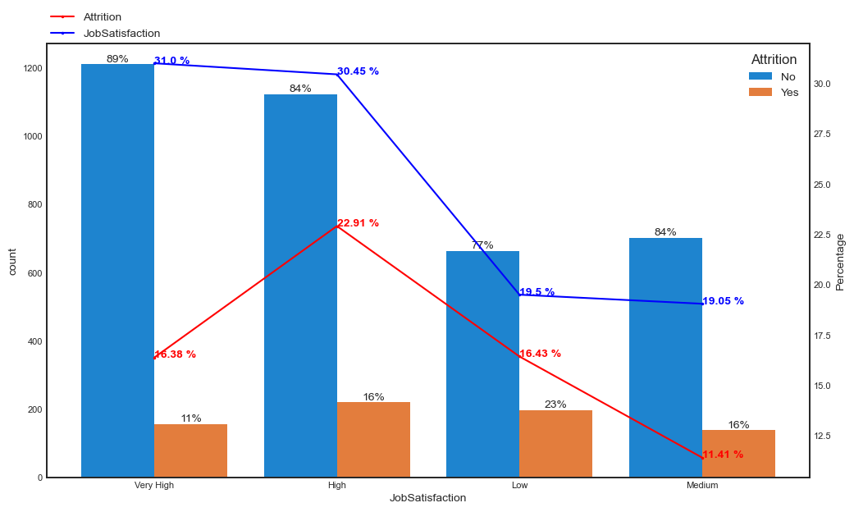
Univariate Analysis
Employees with a High `Jobsatisfaction` have a marginally higher attrition rate compared to other satisfaction levels.

Slide 17
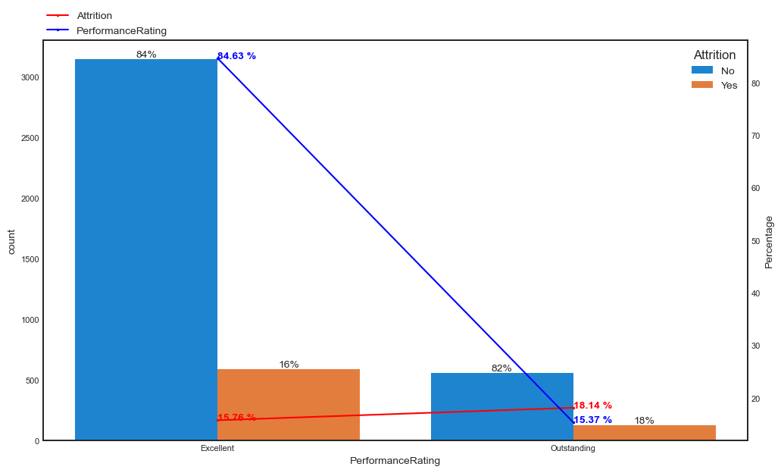
Univariate Analysis
Even for the variable `PerformanceRating` the attrition rate is steady across these the two levels `Excellent` and `Outstanding`

Slide 18
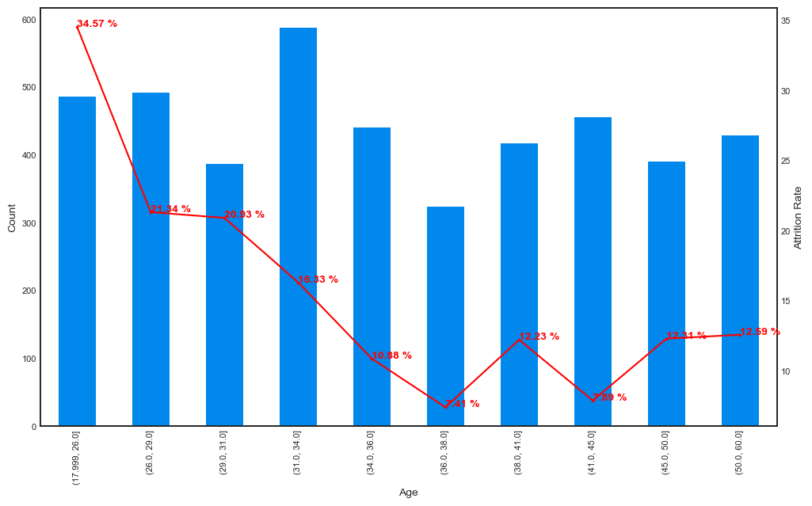
Univariate Analysis
Attrition rate decreases with increase in age till 35 and then afterwards follow a zig zag trend`

Slide 19
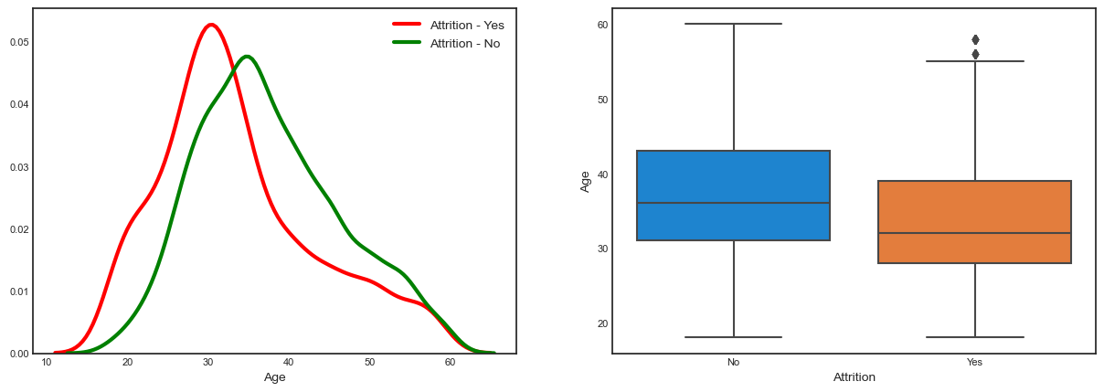
Univariate Analysis
Attrition rate decreases with increase in age till 35 and then afterwards follow a zig zag trend`

Slide 20
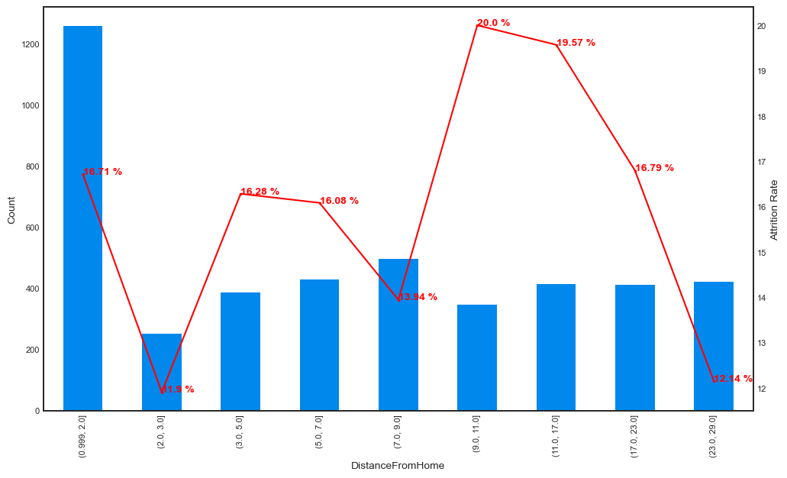
Univariate Analysis
There is no clear trend between Attrition rate and DistanceFromHome. However, the rate is high among who are almost 10km away from home.

Slide 21
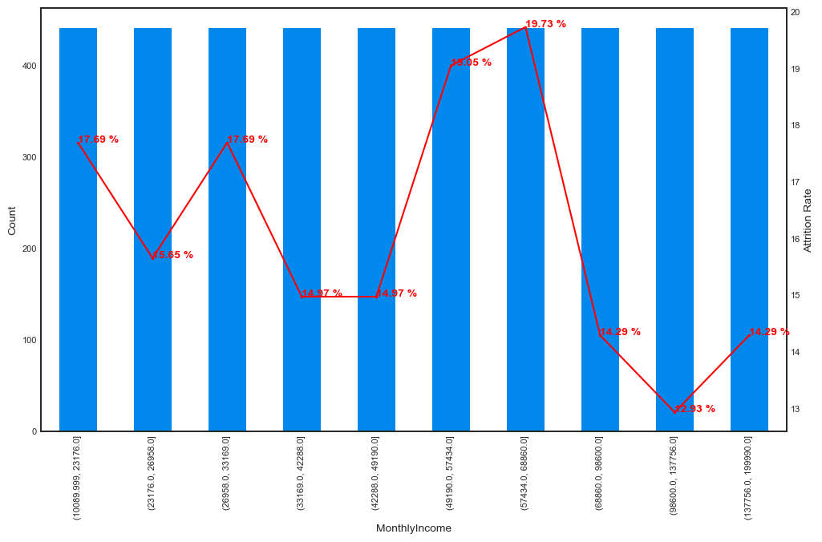
Univariate Analysis
Attrition rate is high among employees who earn between 49k to 68k

Slide 22
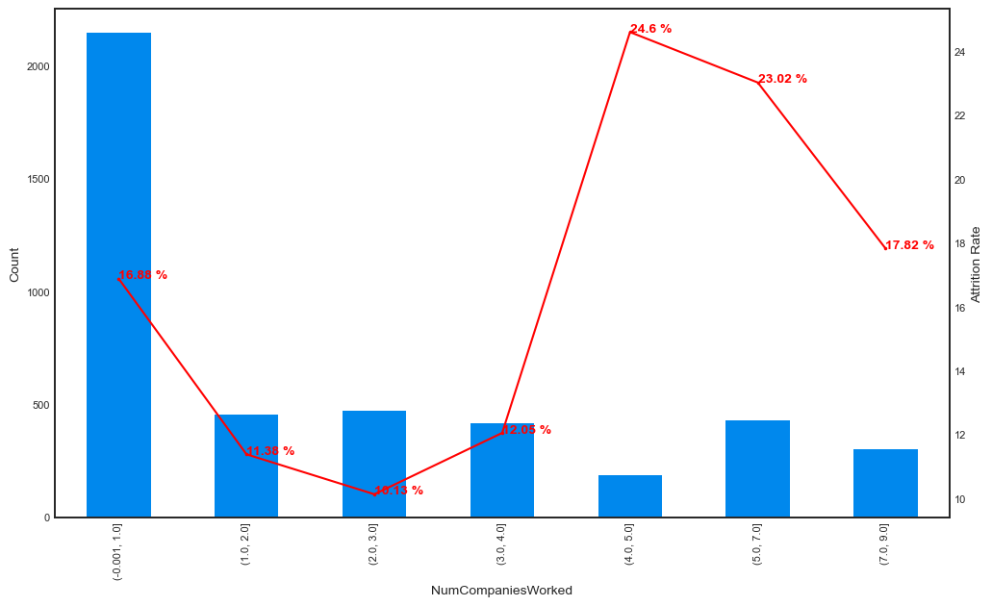
Univariate Analysis
People who use to switch companies in the past show high attrition rate. This is the lowest among employees who have worked in just 2 to 3 companies.
Freshers contribute the highest to the population share and have a attrition rate of 16%

Slide 23
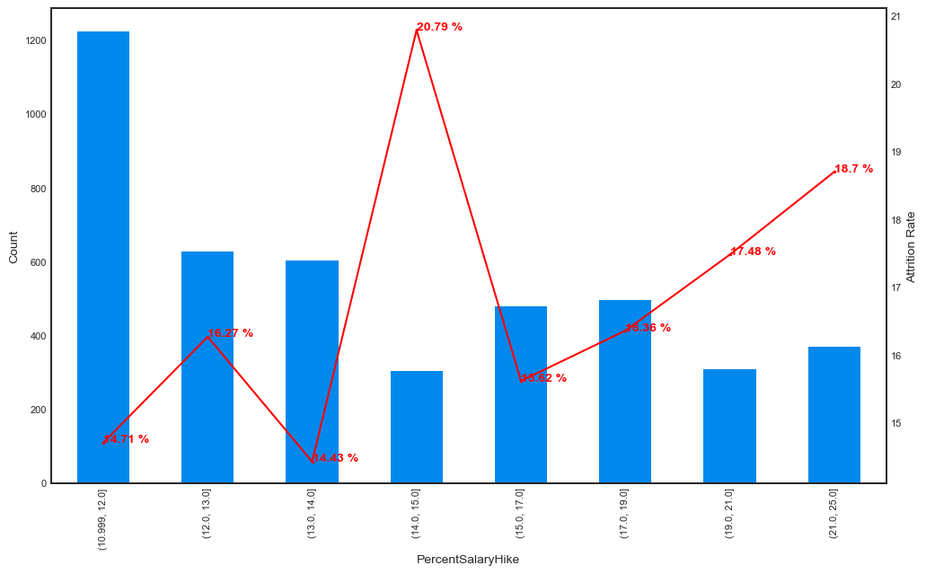
Univariate Analysis
Usually majority of the employees a hike of 11% to 14% and the attrition tend to get increase with a hike of more than 17%
Attrition is the highest among the employees who have received a hik eof 15%

Slide 24
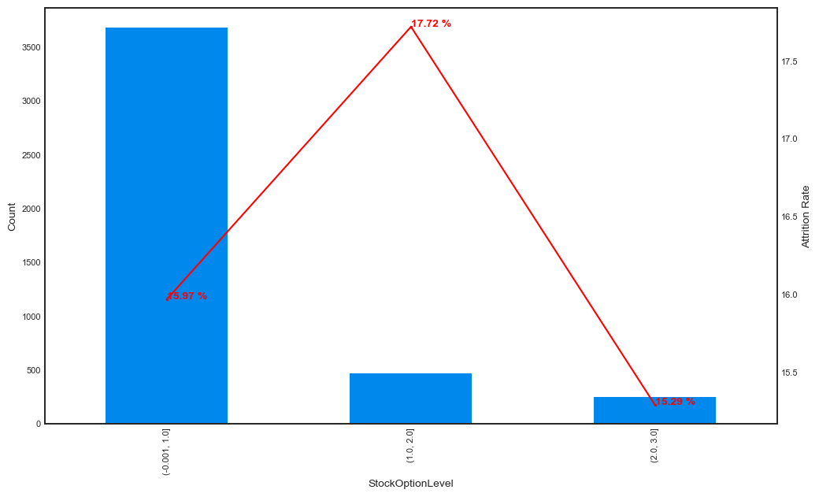
Univariate Analysis
`StockOptionLevel` has almost no effect on attrition rate. It appears to be almost constant across different levels
Most of the employees have a `StockOptionLevel` of 1

Slide 25
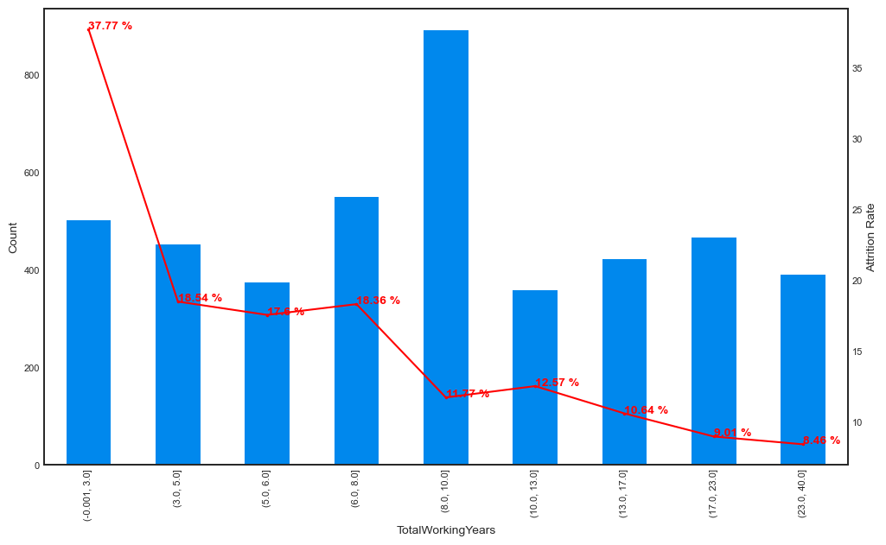
Univariate Analysis
Attrition rate tends to decrease with increase in `TotalWorkingYears`
It is highest among employees who have less than 3 years of Workexperience and the lowest among employees with more than 23 years of work experience.

Slide 26
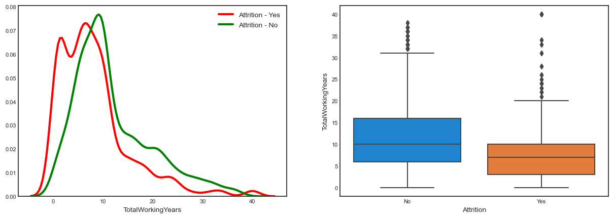
Univariate Analysis
Attrition rate tends to decrease with increase in `TotalWorkingYears`
It is highest among employees who have less than 3 years of Workexperience and the lowest among employees with more than 23 years of work experience.

Slide 27
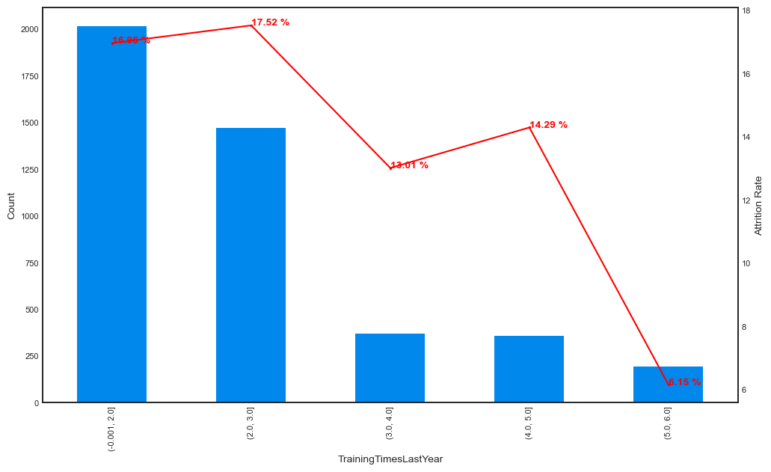
Univariate Analysis
Employees who frequently get upskilled tend to stay with the company more and those who had a limited exposure to training (less than 3 `TrainingTimesLastYear`) tend to leave the company soon.

Slide 28
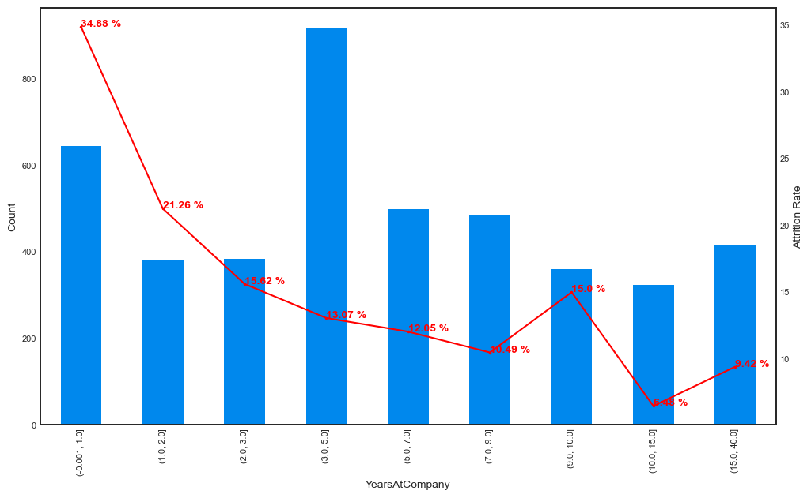
Univariate Analysis
Employees who were loyal to the company and stayed for a long time tend to remain in the company
Attrition rate is highest for emloyees (almost 34.88%) who have stayed just an year or less with company

Slide 29
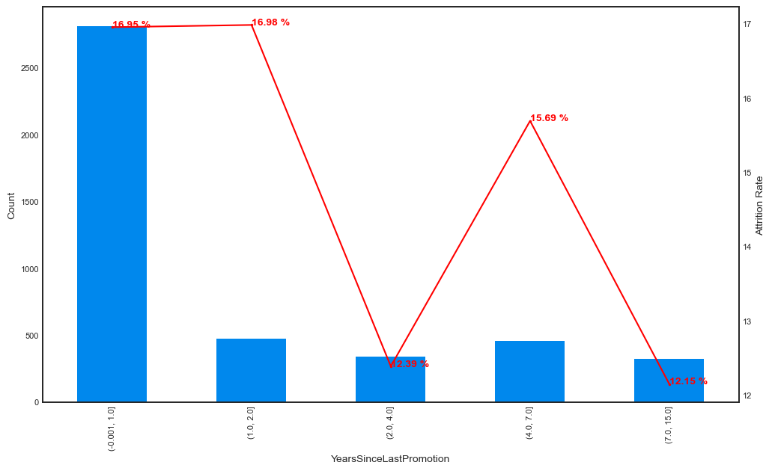
Univariate Analysis
Employees who received a promotion last year of the year before tend to have a higher attrition rates

Slide 30
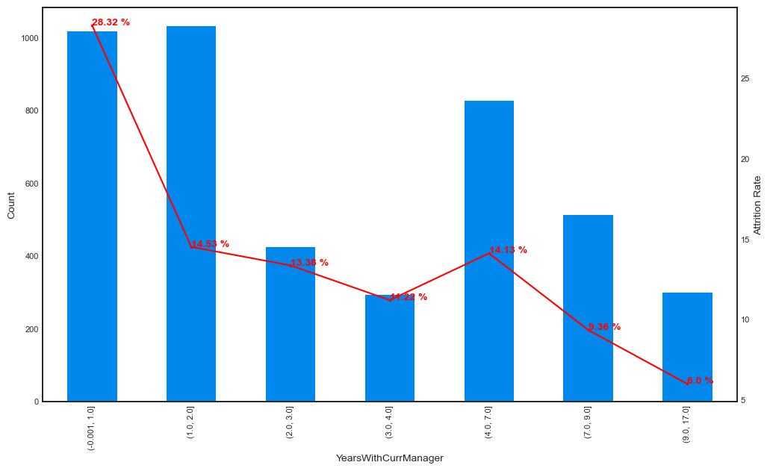
Univariate Analysis
As one stays more years under the current manager, they tend to do not leave the organization
Attrition rates are highest among the employees who have stayed less than a year with their current manager (almost 28.32%)

Slide 31
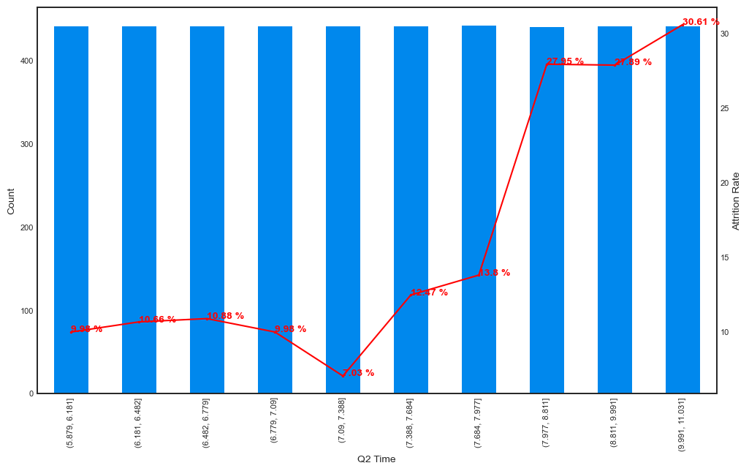
Univariate Analysis
As expected employees who work more than 8 hrs have a higher risk of attrition

Slide 32
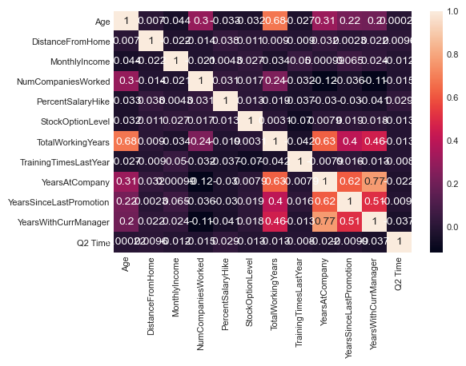
Correlation Analysis – Numerical variables
Most of the correlations are weak. From the below heat map we can see that Age is correlated with totalworking years, years at company with years withcurrent manager, total working years with years at company

Slide 33
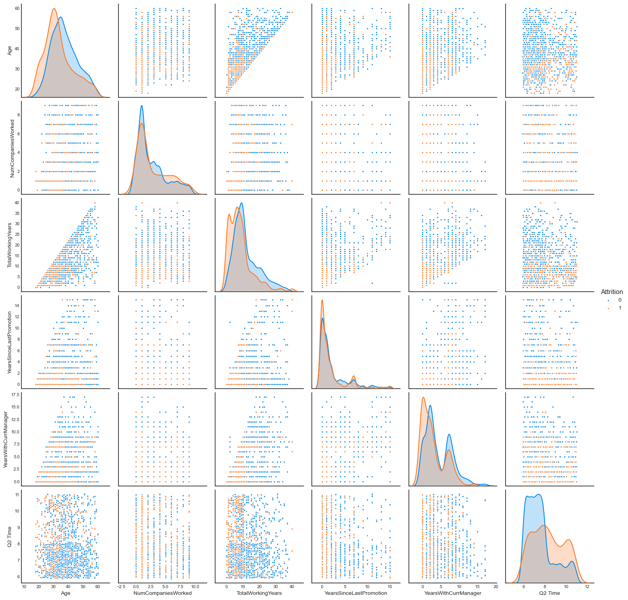
Correlation Analysis – Numerical variables

Slide 34
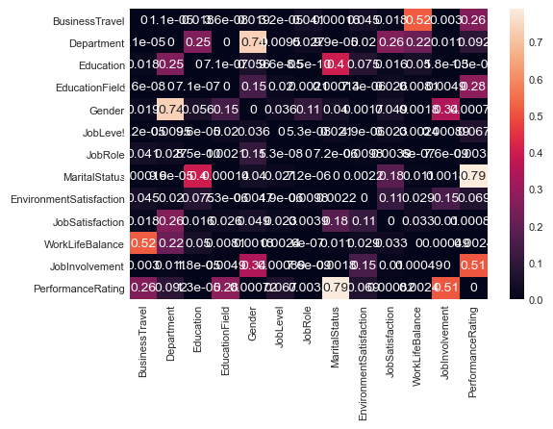
Correlation Ratio Analysis – Categorical variables
Most of the correlations are weak. From the below heat map we can see that BusinessTravel is related to WorklifeBalance, Educatin with Marital status, Gender with Department and Marital status with PerformanceRating

Slide 35
Modelling Approach
We use the Logistregression from the statsmodel to fit our data
All the categorical variables are converted to indicator variables with one hot encoding
We split the data sets into train and test datasets with 0.7 and 0.3 proportion respectively.
The split is done in such way that the class imbalance is preserved in test dataset and is almost same as that of train dataset. (83%, 16%)
We’ve scaled all the numeric variables using Robustscalar

Slide 36
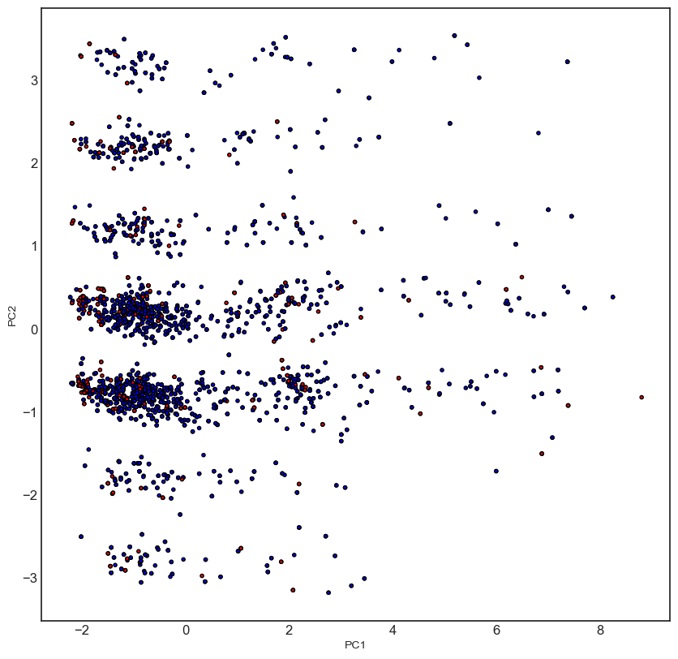
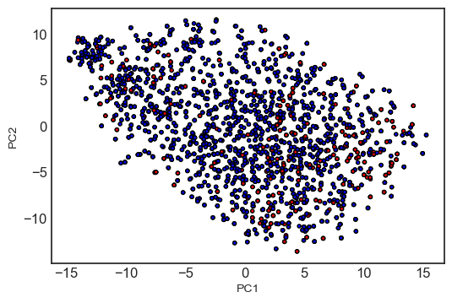
Modelling Approach
Dataset visualization – there is no clear decision boundary from the 2d representation of datset via PCA and t-SNE

Slide 37
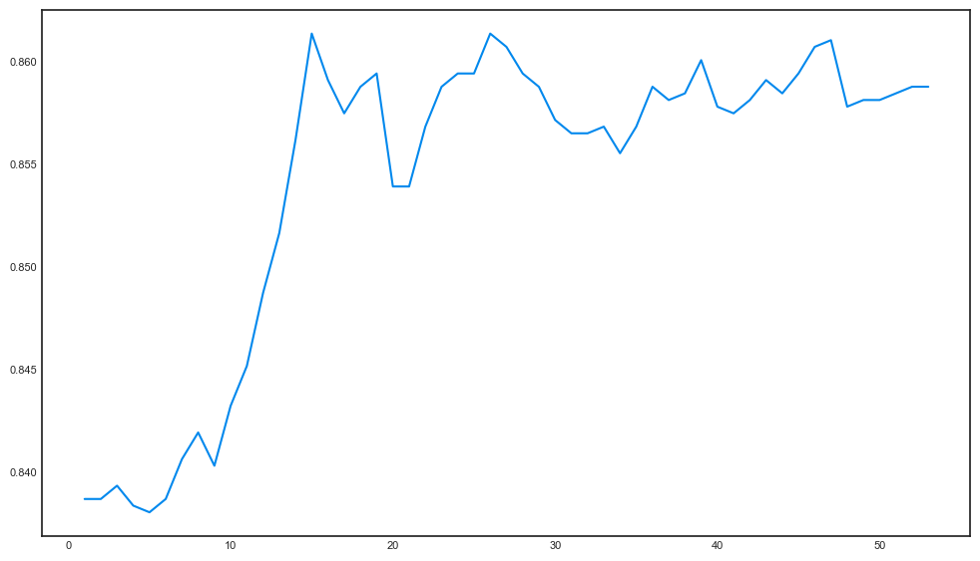
Modelling Approach
We tried different feature selection approaches and finally sticked to the 20 features using RFE. The optimal number of 20 is chosen by looking the 5 fold cross validation of the dataset on a logistic regression model

Slide 38
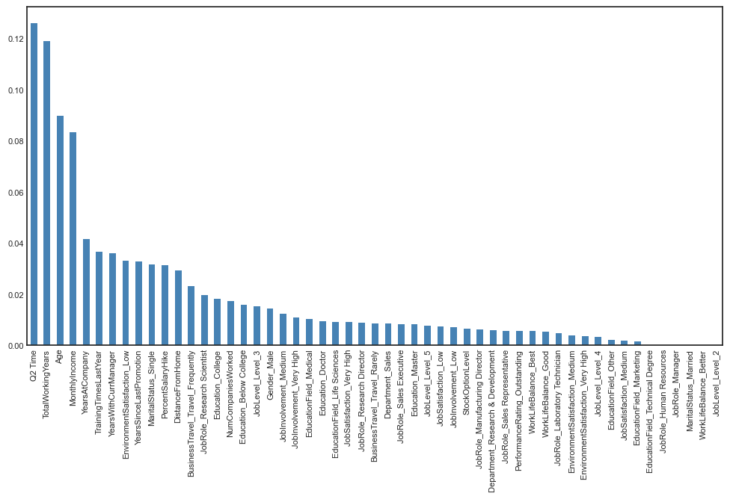
Modelling Approach – Feature Importance

Slide 39
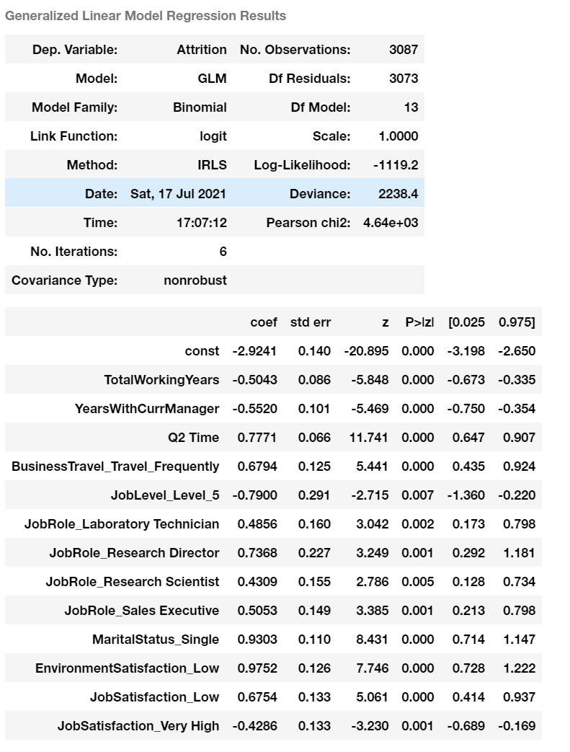
Modelling Approach
We’ve iteratively build 8 models from these 20 features after accounting for a vif threshold of 2 and ignoring any non significant variables in the model.

Slide 40
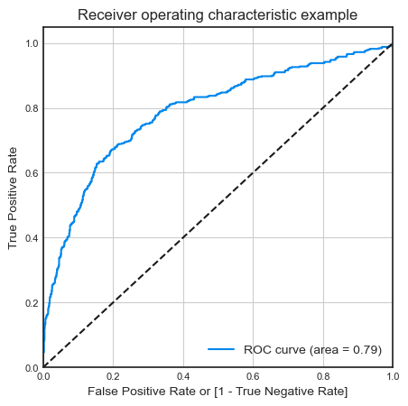
Modelling Approach
The final model has an AUC of 0.79 on train dataset

Slide 41
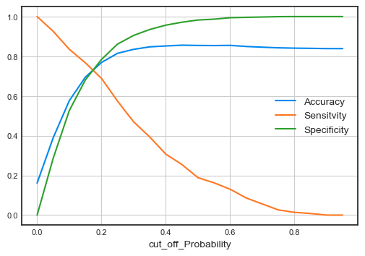
Modelling Approach
From the below curve, 0.20 is the optimum point for taking probability cutoff as the meeting point is slightly before from 0.20 hence final cutoff we choose is 0.20. Also we can see that there is a trade off between sensitivity and specificity.
Our precision percentage is 38% approximately and recall percentage is 69%
This means we have very good model which explains relevancy of 69% and true relevant results about 38%.

Slide 42
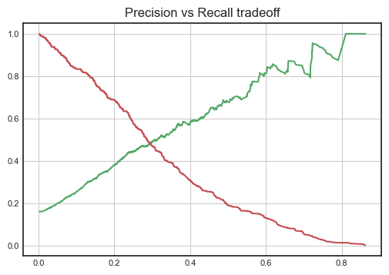
Modelling Approach
As we can see that there is a trade off between Precision and Recall and the meeting point is nearly at 0.3

Slide 43
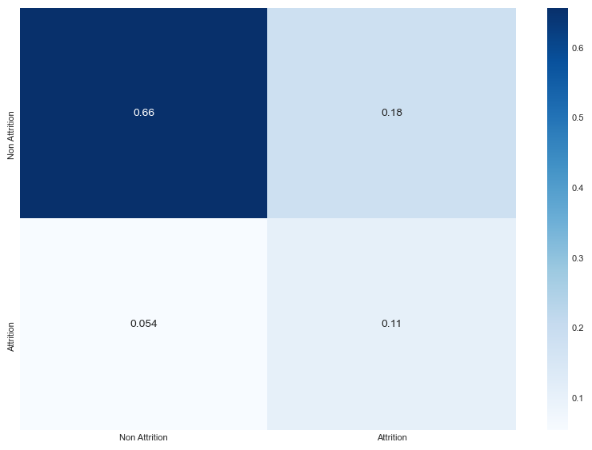
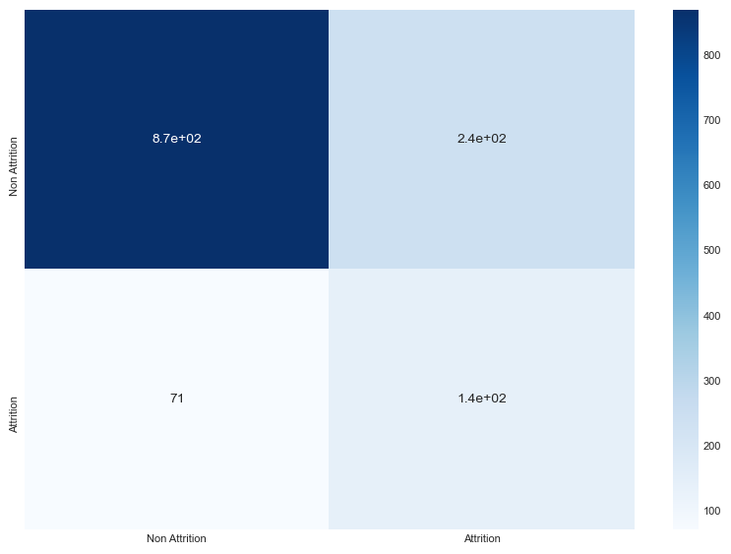
Modelling Approach
Precision score in test dataset: 0.37
Recall score in test dataset: 0.67
The model has an accuracy of 76 on the test dataset

Slide 44
Conclusion
The Accuracy, Precision and Recall score we got from test set in aceptable range.
This concludes that the model is in stable state.
Final features from our model which contributes more towards the probability of a attrition are :
- **TotalWorkingYears**
- **YearsWithCurrManager**
- **Q2 Time**
- **BusinessTravel_Travel_Frequently**
- **JobLevel_Level_5**
- **JobRole_Laboratory Technician**
- **JobRole_Research Director**
- **JobRole_Research Scientist**
- **JobRole_Sales Executive**
- **MaritalStatus_Single**
- **EnvironmentSatisfaction_Low**
- **JobSatisfaction_Low**
- **JobSatisfaction_Very High**

